Slide 1
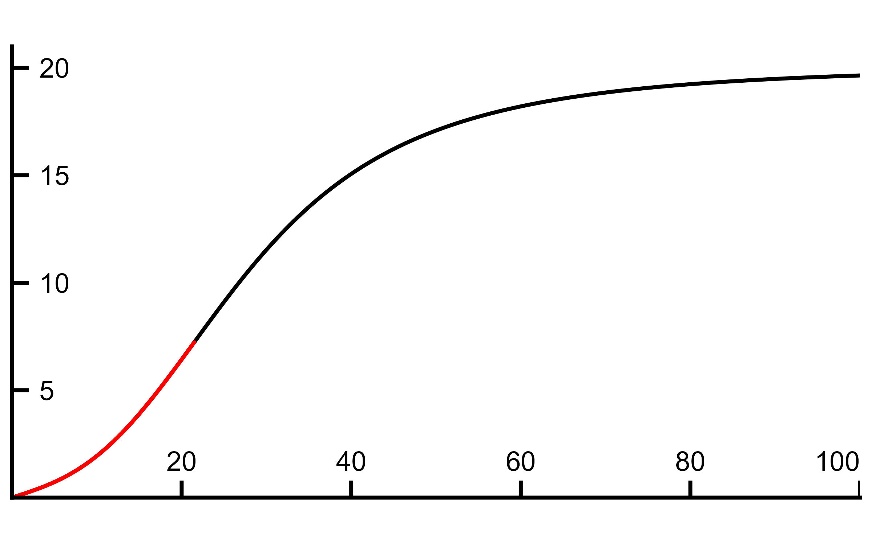







$$\dot{Q}(C_{a}−C({PO}_{2,c}))={\dot{V}O}_{2}=D_{O_{2}}({PO}_{2,c}−{PO}_{2,m})$$
$${\dot{V}O}_{2}=\dot{Q}(C_{a}−C({PO}_{2,c}))$$
$${\dot{V}O}_{2}=D_{O_{2}}({PO}_{2,c}−{PO}_{2,m})$$
$$\dot{Q}$$
$$C_{a}$$
mL O₂ ∙ dL⁻¹
$$C_{v}$$
${PO}_{2,c}$ (mmHg)
$${PO}_{2,m}$$

